Slide 1
MAJOR PROJECT PRESENTATION
TOPIC – FACE RECOGNITION SYSTEM WORK FROM HOME DETECTION
Made and Submitted by -
ARUN & AASHUTOSH
Under the guidance of
VIKAS KUCHHAL SIR

Slide 2
Outline -
Introduction
Objectives
Hardware Software specifications
Working
References

Slide 3
Introduction
Face Recognition is a biometric method of identifying an individual by comparing live capture or digital image data with stored record for that person.
Work from home detection is ensuring the employees is working professionally at home .
Provides an log file which maintains presence of an employee at a specific time.

Slide 4
Objective
In this project We (Arun & Aashutosh) have made an python GUI integrated WFH-DETECTION App which verify the employe face for his presence with respect to time.
In this project, we have made a WFH-DETECTION app which ensures the user is doing his work professionaly and prepare a log file for his presence in front of the machine(camera) and can be run by any user as it is integrated with GUI.

Slide 5
Hardware specifications:
Processor: Intel(R) Core(™) i3-8145U CPU @ 2.10Ghz 2.30 GHz
Installed memory (RAM): 4.00 GB (3.86 GB usable minimum)
System type: 64-bit Operating System, x64-based processor
Software specifications:
Python (version == 3.7.1)
Visual studio code
Face recognition library
MYSQL 5.5
Tkinter for GUI support

Slide 6
What is face recognition?
A face recognition is a computer application for automatically identifying or verifying a person from a digital image or a video frame from a video source.
One of the ways to do this is by comparing selected facial features from the image and facial database.

Slide 7
Implementation of face recognition:
The implementation of face recognition technology includes the following three stages:
Image accquisition.
Image processing.
Face image classification and decision making.

Slide 8
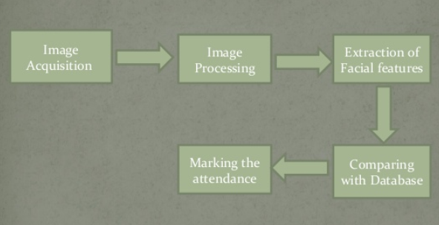
Block diagram:
Writing a log file
Comparing with captured image

Slide 9
Image acquisition:
Facial-scan technology can acquire faces from almost any static camera or video system that generates images of sufficient quality and resolution.
High-quality enrolment is essential to eventual verification and identification enrolment images define the facial characteristics to be used in all future authentication events.

Slide 10
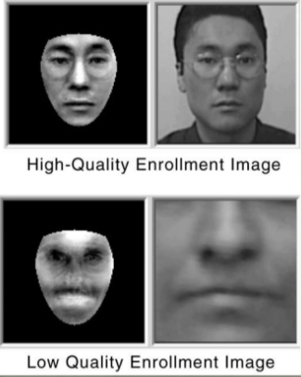

Slide 11
Image Processing:
Images are cropped and color images are normally converted to black and white in order to facilitate initial comparisons based on gray scale characteristics.
First the presence of faces or face in a scene must be detected. Once the face is detected, it must be localized and normalization process may be required to bring the dimensions of the live facial sample in alignment with one on the template.

Slide 12
Extraction of Facial features:
All facial-scan systems attempt to match visible facial features in a fashion similar to the way people recognize one anpther.
The features most often utilized in facial-san systems are those least likely to change significantly over time: upper ridges of the eye sockets, area around the cheekbones, sides of the mouth, nose shape, and the position of major features relative to each other.

Slide 13
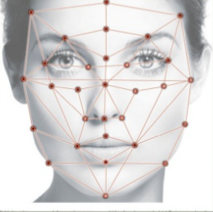
How Facial Recognition System Works
Every face has atleast 80 distinguishable parts called nodal points.

Slide 14
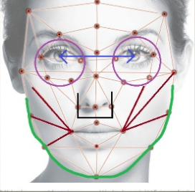
How Facial Recognition System Works:
Here are few nodal points below:
Distance between the eyes
Width of the nose
Depth of eye sockets
Structure of the cheek bone
Length of jaw line

Slide 15
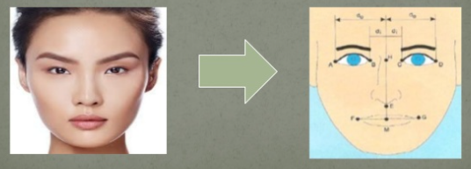
Continued...
A general face recognition software conducts a comparison of these parameters to the image in its database.
Depending upon the matches found, it determines the result.
This technique is known as feature based matching and it is the most basic method of facial recognition.

Slide 16
Applications:
Primary application being used in firms/classrooms to mark the entry/attendance of employees/students and foe ensuring the presence .
Decrease the false entry.
Security/Counterterrorism: Access control, comparing surveillance images to know terrorist.
ATM: The software is able to quickly verify a customer’s face.
Healthcare: Minimize fraud by verifying identity.

Slide 17
Technology used:
Tkinter for graphical user interface
OpenCV for taking images and face recognition
(cv2.face.LBPHFaceRecognizer_create())
Modules - CSV,, os datetime etc. for other purposes.

Slide 18
Features:
Easy to use with interactive GUI support.
Create/Update log(text) file on connection.
Create a new log(text) file everyday for presence of face and Write it in a log file with proper date and time.
Send)mail) to the head with user details and log file.

Slide 19
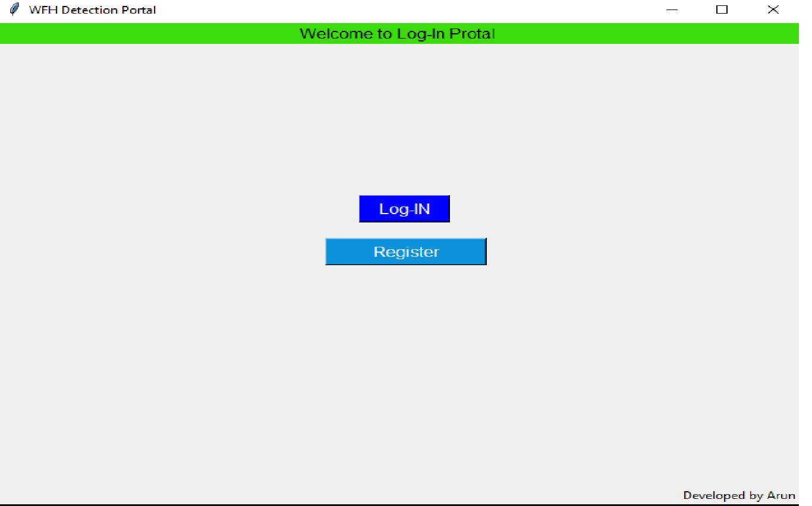
SCREENSHOTS OF PROJECT
MAIN SCREEN:

Slide 20
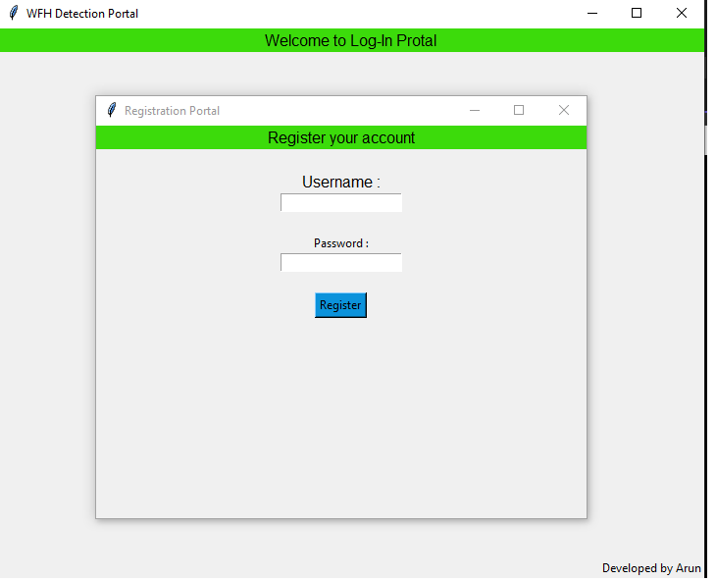
REGISTER

Slide 21
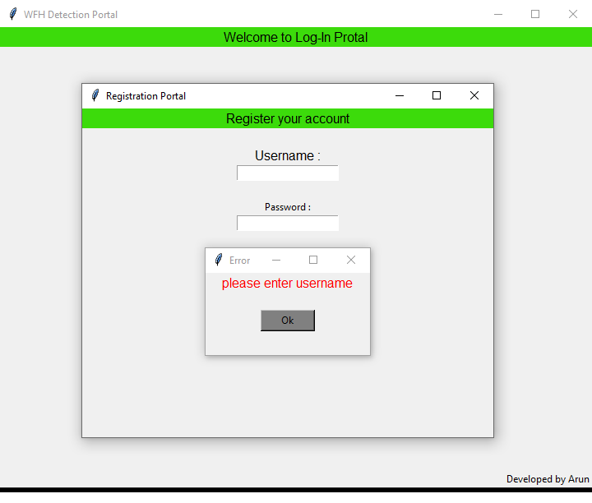
REGISTER:ENTER USERNAME

Slide 22
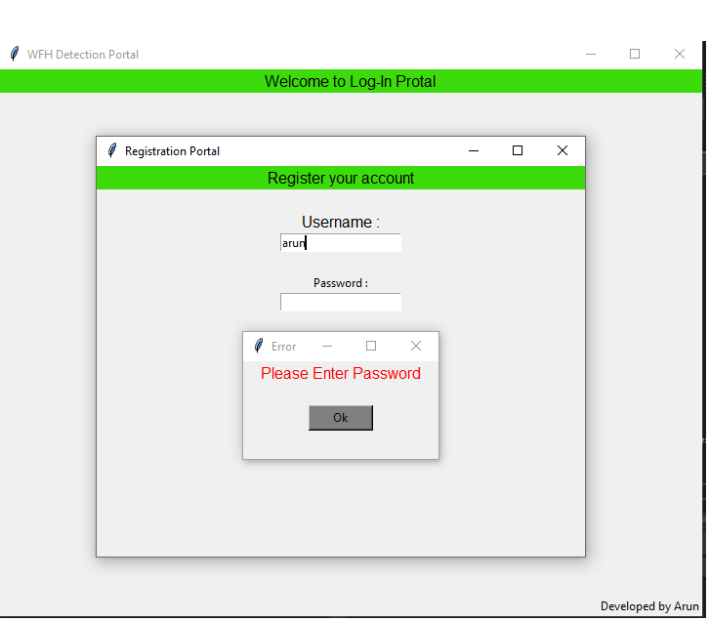
REGISTER: ENTER PASSWORD

Slide 23
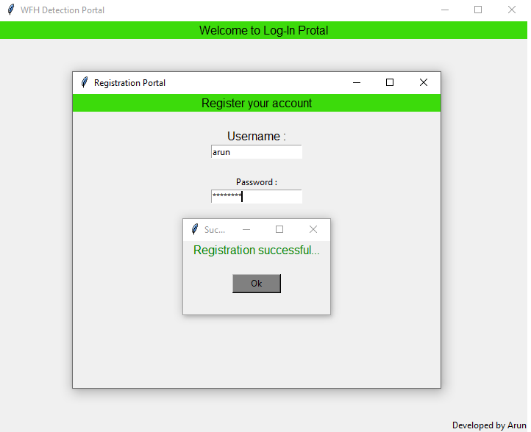
REGISTER SUCCESS:

Slide 24
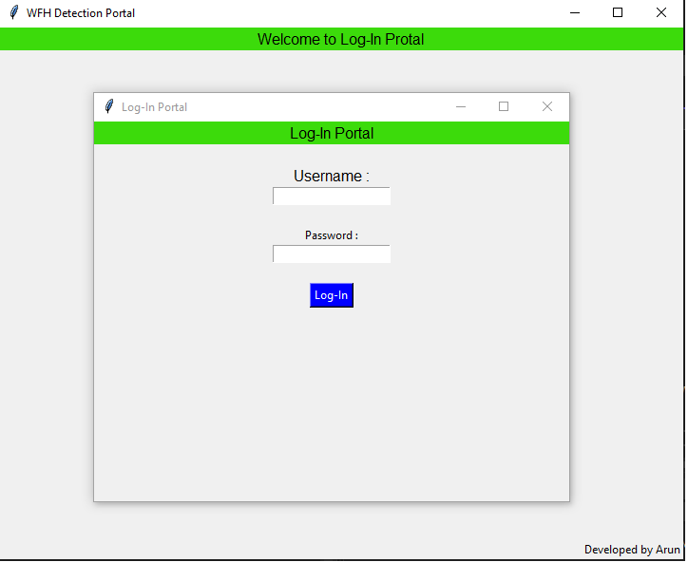
LOGIN:

Slide 25
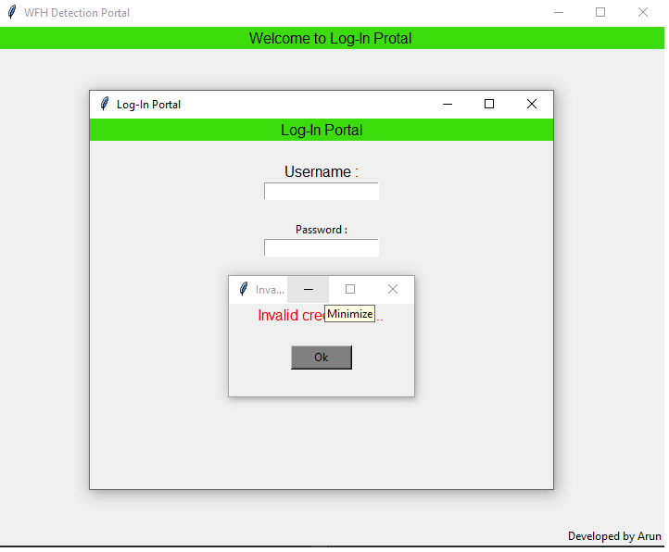
LOGIN: INVALID CREDENTALS

Slide 26
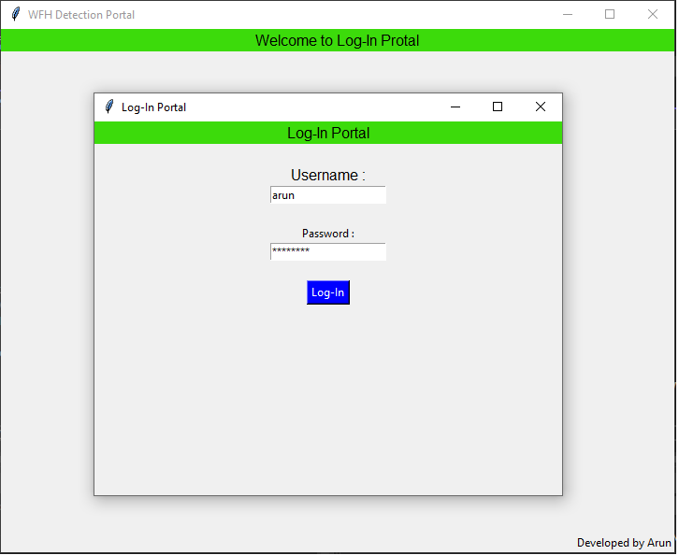
LOGIN ….:

Slide 27
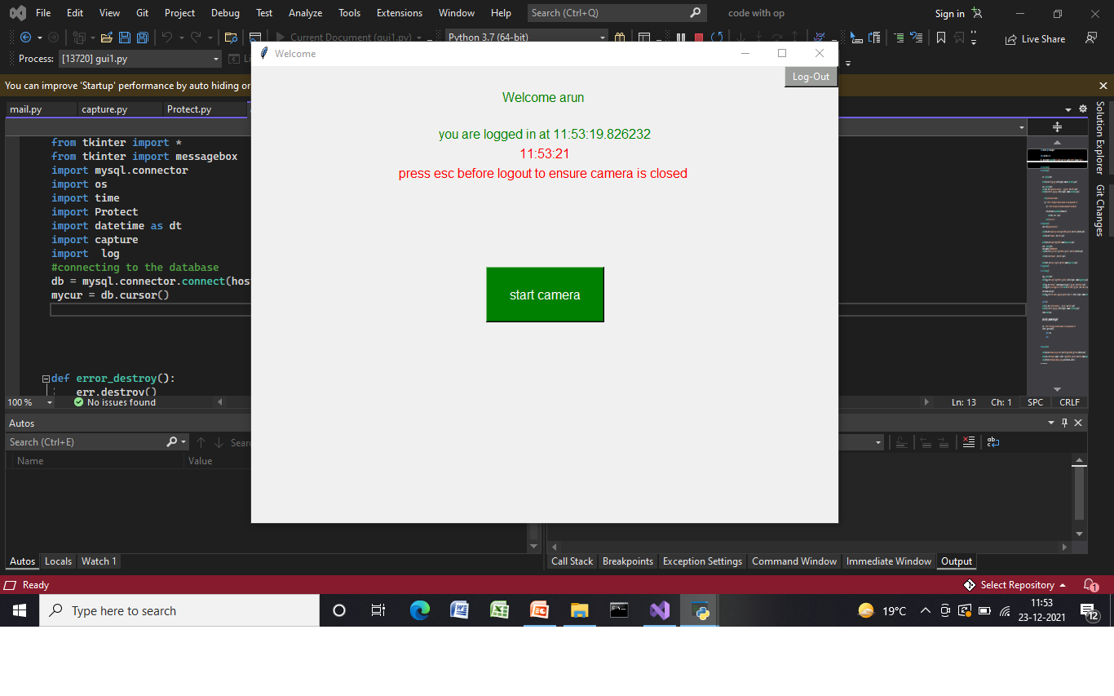
LOGGED IN:

Slide 28
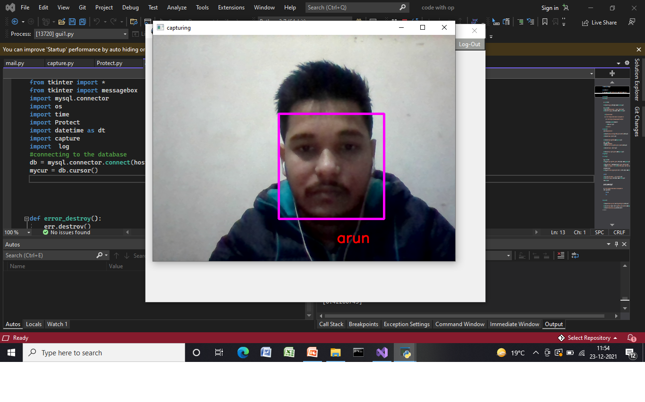
START CAMERA:

Slide 29
Log file
################### file updated at 2021-06-08 00:59:13.078601 . ######################################
arun login at 00:59:16.578510.
Image captured at 00:59:17.828445.
Unable to identify the faces => Time : 00:59:19.250919 .
Unable to identify the faces => Time : 00:59:19.647672 .
[Match Found] ==> Time : 00:59:20.806870 .
.
Unable to identify the faces => Time : 01:00:28.767610 .
mail send successfully .
arun logged out at 01:00:28.768609.
Total active time is 0:01:10.940164 sec .
============== face is detecting for 0 sec . ========================
============== face is not detecting for 60.22669990000001 sec . ========================
============== unknown face is detecting for 0 sec . ========================

Slide 30
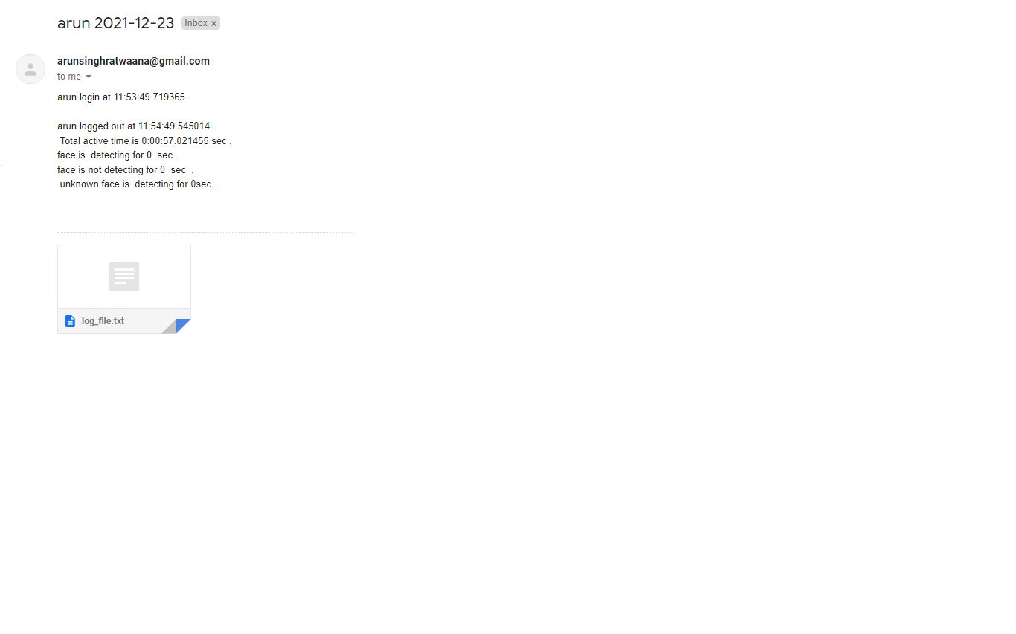
E-mail: summary attached with log file .

Slide 31
References:
To understand the implementation of Face Recognition concept to use in our project we read some previously published research papers on internet and articles related to the same for reference. The links to the resources that helped us in making this project are given below:
https://www.researchgate.net/publication/326986115_Face_Detection_and_Recognition_Student_Attendance_System
https://nevonprojects.com/face-recognition-attendance-system/
https://www.youtube.com/watch?v=sz25xxF_AVE
https://realpython.com/python-gui-tkinter/
https://docs.opencv.org/master/d9/df8/tutorial_root.html

Slide 32
Thank You!

